Slide 1
Clever Hans, Clever Algorithms: Are your machine learnings learning what you think?
Bob L. Sturm
School of electronic engineering and computer science
Queen mary University of London

Slide 2
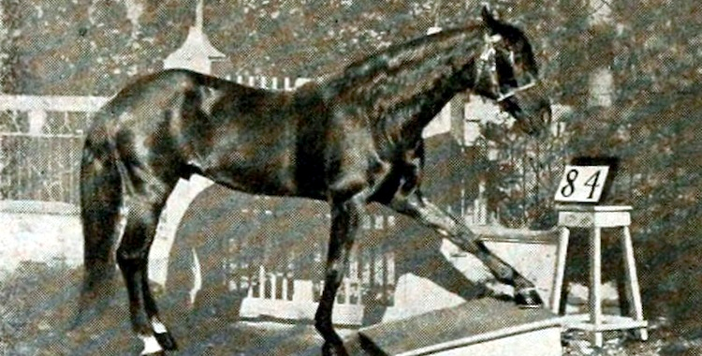
The horse hans
Are you
suspicious?
O. Pfungst, Clever Hans (The horse of Mr. Von Osten): A contribution to experimental animal and human psychology. New York: Henry Holt, 1911.

Slide 3
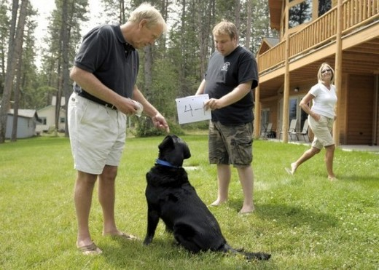
The Dog Beau
Are you
suspicious?
http://www.dailymail.co.uk/news/article-2026905/ Meet-Beau-The-maths-genius-dog-add-subtract-square-roots--long-gets-biscuit-return.html

Slide 4
The Cat chas
Are you
suspicious?
http://www.dailymail.co.uk/news/article-2153314/ Arthur-Farminers-codebreaking-cat-Chas-helps-owner-solve-word-puzzle-putting-paw-final-answer.html

Slide 5
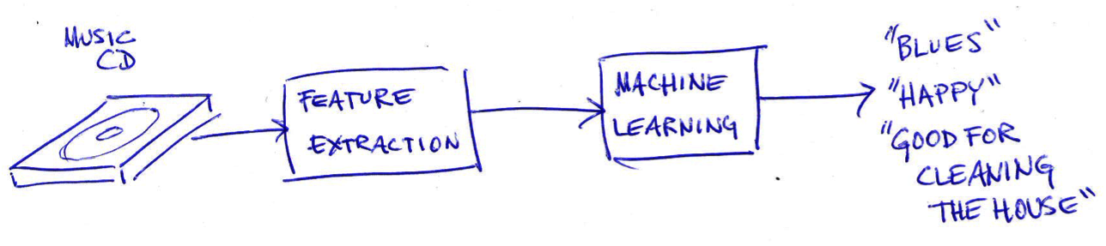
The Music Listening machine XYZ
Are you
suspicious?

Slide 6

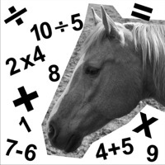
WHY be less suspicious of one
?

Slide 7
WHY is that important
?

Slide 8
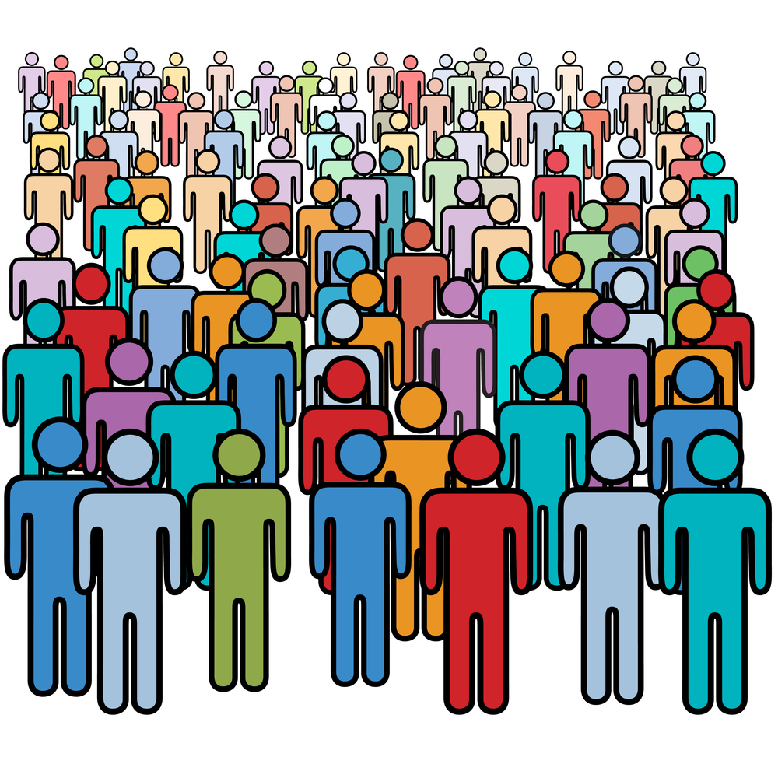

What do we want to do?
Connect users with music and information about music
Help users make music and information about music
Develop new technologies and show that they contribute
People, Scholars, Musicians, Schools, Organisations, Archives, Rights holders, Businesses, …
Michael Tompsett, Musical Instruments Map Of The World Map (http://fineartamerica.com)
M. Casey, R. Veltkamp, M. Goto, M. Leman, C. Rhodes, and M. Slaney, “Content-based music information retrieval: Current directions and future challenges,” Proc. IEEE, vol. 96, pp. 668-696, Apr. 2008.

Slide 9
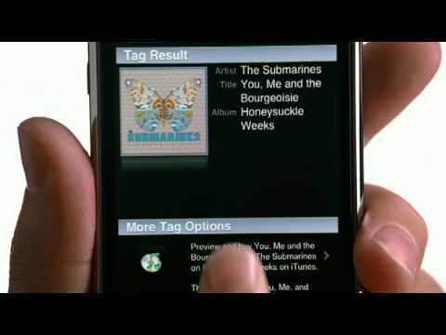

Why do we want to do that?
Music is everywhere, and so is the need for music and information about music.
User scenario: (Scene: In a pub or gym or movie) What is this song? I want to buy it!

Slide 10
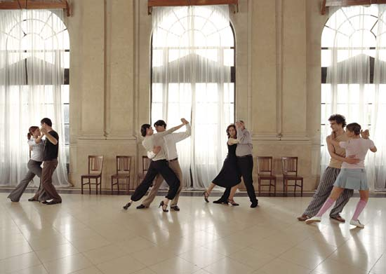
Why do we want to do that?
Music is everywhere, and so is the need for music and information about music.
User scenario: Which new songs in our school’s music collection could be good for tomorrow’s lesson about Tango dancing?

Slide 11

Why do we want to do that?
Music is everywhere, and so is the need for music and information about music.
User scenario: Can we find production music fitting the mood and style of our commercial?

Slide 12
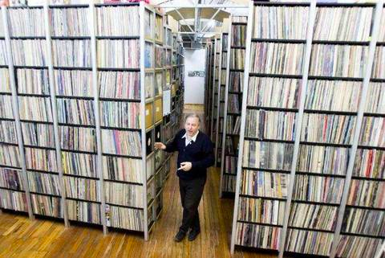
Why do we want to do that?
Music is everywhere, and so is the need for music and information about music.
User scenario: How can we make our recordings archive meet the information needs of musicologists, composers, musicians, sociologists, journalists, etc.?

Slide 13
how can we do that
?

Slide 14

How can we do that?
Let’s have professional musicologists listen to the music and then describe it (and build a radio station around all that music).

Slide 15
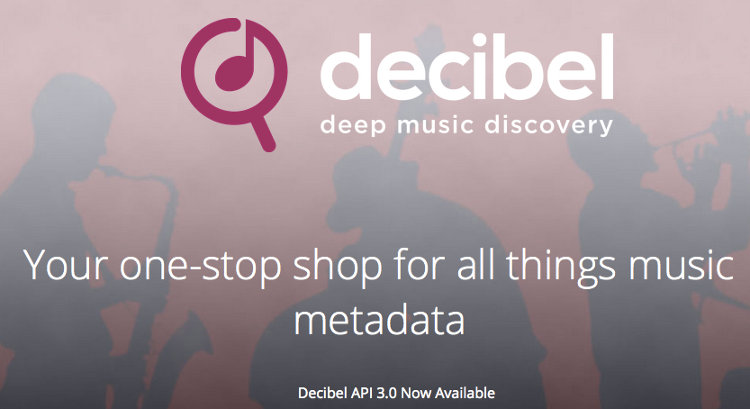
How can we do that?
Let’s hire professionals to listen to the music and create metadata, and then provide that metadata to subscribers.

Slide 16

An Apocryphal story?
Microsoft estimated it would take 30 person-years for musicologists to create metadata describing just 100,000 songs.
J.-J. Aucouturier and F. Pachet, “Representing music genre: A state of the art,” J. New Music Research, vol. 32, no. 1, pp. 83–93, 2003.
3,000 person-years for the 10 million songs in the Shazam database.

Slide 17
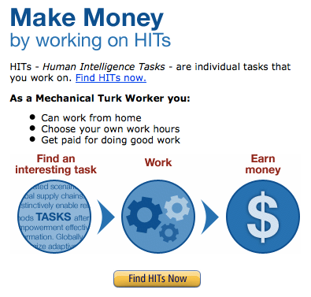

How can we do that?
Let’s pay someone/anyone to create (good) metadata!

Slide 18
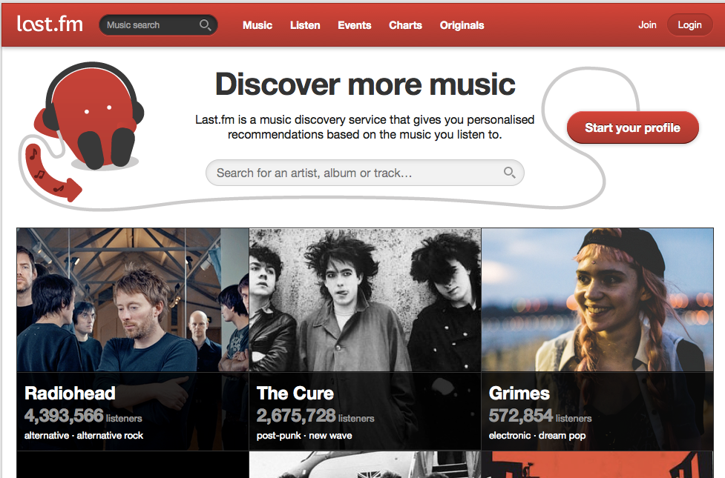
How can we do that?
Let’s have users create the metadata!

Slide 19
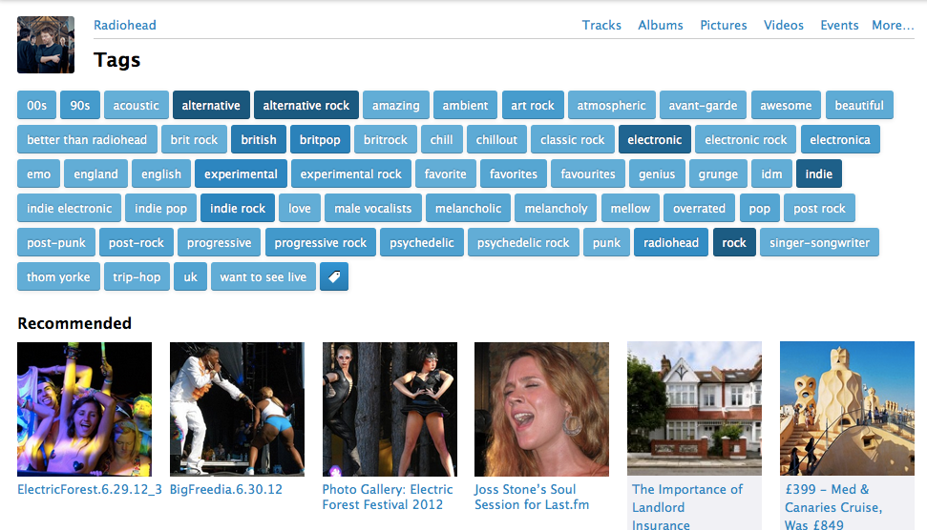
How can we do that?
Let’s have users provide the metadata!

Slide 20
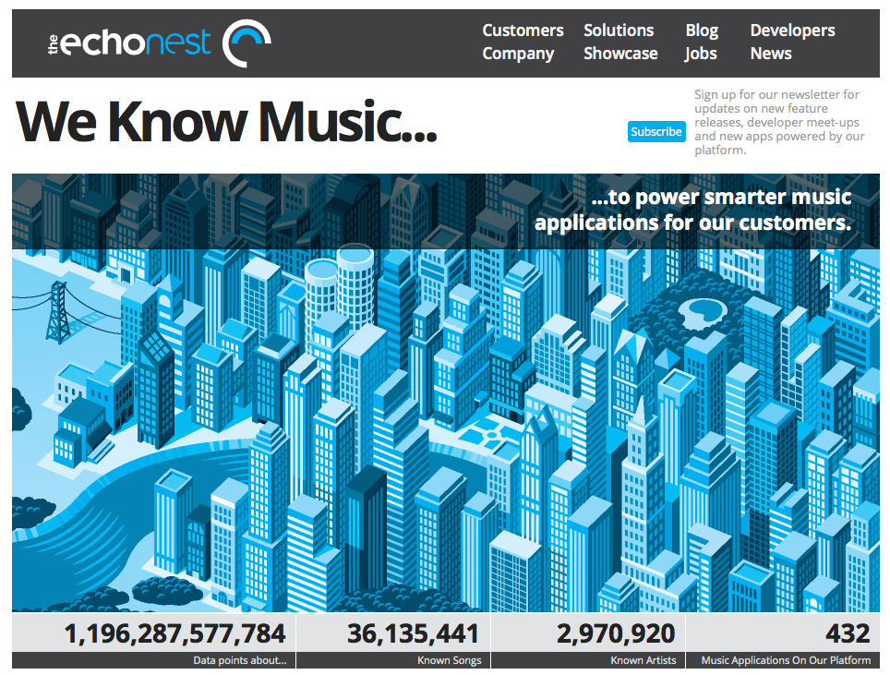
How can we do that?
Let’s build ALGORITHMS to listen and create the metadata!

Slide 21

How can we do that?
Machine music listening is profitable business!
$100 million March 2014
http://www.digitalmusicnews.com/permalink/2014/03/07/spotify100m

Slide 22
Simply, WE must create machine music listening systems

Slide 23
How’R we Doing
?

Slide 24
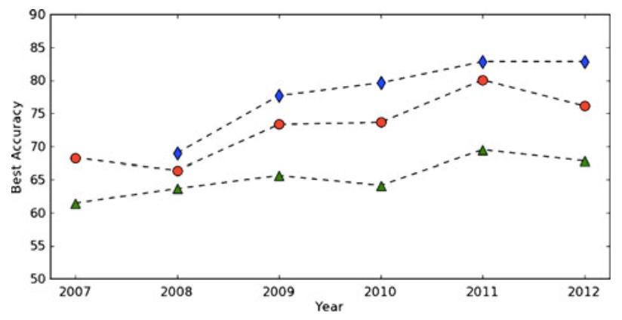
Wonderful performAnce is wonderful!
Sturm, “The GTZAN dataset: Its contents, its faults, their effects on evaluation, and its future use,” http://arxiv.org/abs/1306.1461, 2013.
Chord rec.
Genre rec.
Mood rec.
Humphrey, Bello, & LeCun, “Feature learning and deep architectures: New directions for music informatics,” J. Intell. Info. Systems, vol. 41, no. 3, pp. 461-481, 2013.

Slide 25
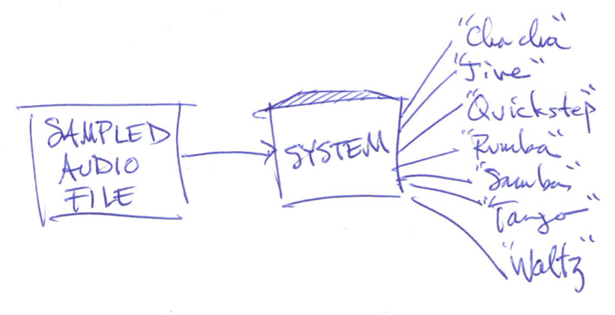

One state of the art example system
Classify input music recording as ballroom dance style.
Use deep learning of time-domain autocorrelations.
(Similar system won an annual machine music listening competition in Latin music classification in 2013.)

Slide 26
One state of the art example system
Deep learning architecture:
Stacked restricted Boltzmann machines
Sigmoid activations
Input of size 800
Five fully connected hidden layers with sizes 500, 500, 500, 500, & 2000 neurons
Softmax output of size 7 (posterior in each class)
Code adapted from the Salakhutdinov and Hinton deep autoencoder for MNIST digits: http://www.cs.toronto.edu/~hinton/MatlabForSciencePaper.html

Slide 27
One state of the art example system
Input features (800 dimensions) are essentially autocorrelations of flattened time-frequency energy distributions.

Slide 28
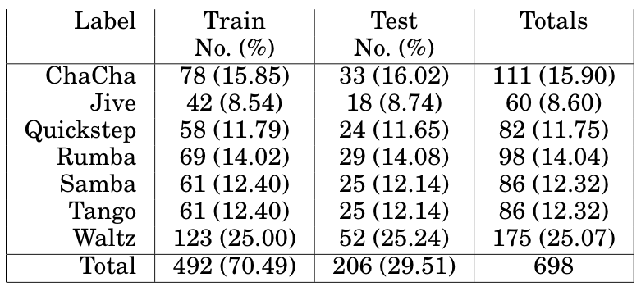
One state of the art example system
Trained and tested in benchmark dataset BALLROOM: to extract and learn “repetitive rhythmic patterns”.
S. Dixon, F. Gouyon, and G. Widmer, “Towards characterisation of music via rhythmic patterns,” in Proc. ISMIR, pp. 509-517, 2004.

Slide 29
Repetitive rhythmic patterns

Slide 30
One state of the art example system
TRUE
Confusion table and other figures of merit show excellent results.
Baseline accuracy: 14.3% (random choice)
How does it compare?

Slide 31
What can we conclude?
System 1: 93.6%
System 2: 91.5%
System 3: 28.5%
Systems 1 and 2 have learned “repetitive rhythmic patterns”.
System 3 has not learned “repetitive rhythmic patterns”.
Systems 1 and 2 are superior to system 3.
Systems 1 and 2 can help connect users with music.
Systems 1 and 2 can help users make music.
Choosing randomly: 14.3%

Slide 32
What can we conclude?
NO!
System 1: 93.6%
System 2: 91.5%
System 3: 28.5%
Systems 1 and 2 have learned “repetitive rhythmic patterns”.
System 3 has not learned “repetitive rhythmic patterns”.
Systems 1 and 2 are superior to system 3.
Systems 1 and 2 can help connect users with music.
Systems 1 and 2 can help users make music.
Choosing randomly: 14.3%

Slide 33
Our state of the art example system
How will the 91.5% system classify these “repetitive rhythmic patterns”?

Slide 34
Our state of the art example system
How will the 91.5% system classify these “repetitive rhythmic patterns”?
Why did that happen?
How is it getting 91.5% correct?
Cha cha cha
Quickstep
Rumba
Waltz

Slide 35
What’s under the hood
?

Slide 36
A look under the hood System 1 (93.6%)
Single nearest neighbor classification using tempo.
Does it achieve 93.6% accuracy because it is detecting “repetitive rhythmic patterns”?

Slide 37
A look under the hood System 2 (91.5%)
Our deep learning system
Does it achieve 91.5% accuracy because it is detecting “repetitive rhythmic patterns”?
Cha cha cha
Quickstep
Rumba
Waltz

Slide 38
System 2, so sensitive
How does performance change with time stretching?

Slide 39
Confounding hurts
These slight tempo changes make our 91.5% accuracy system perform no better than random (14.3%).

Slide 40
Same music, Many classes
Many different classes, but “rhythmic patterns” are not changing.

Slide 41
A look under the hood System 3 (28.5%)
Recognises waltz rhythms and triple meter with perfect F-score.
Only Waltz excerpts in BALLROOM are in triple meter.
Picks randomly for all other rhythms in quadruple meter.
Does it achieve 28.5% accuracy because it is detecting “repetitive rhythmic patterns”?

Slide 42
We can conclude none of these !
System 1: 93.6%
System 2: 91.5%
System 3: 28.5%
Systems 1 and 2 have learned “repetitive rhythmic patterns”.
System 3 has not learned “repetitive rhythmic patterns”.
Systems 1 and 2 are superior to system 3.
Systems 1 and 2 can help connect users with music.
Systems 1 and 2 can help users make music.
Choosing randomly: 14.3%

Slide 43
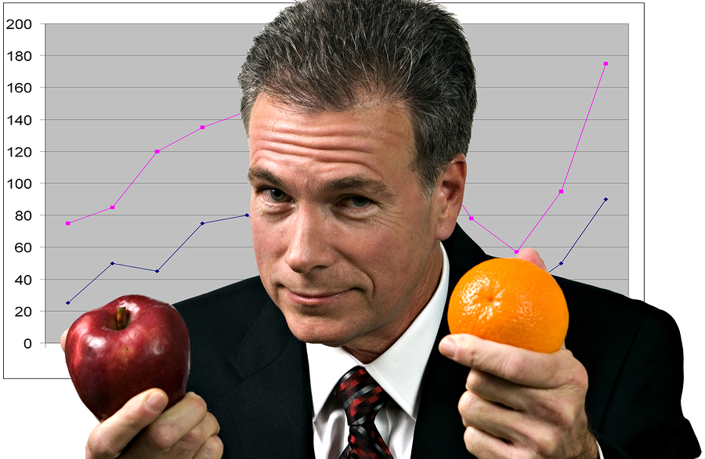
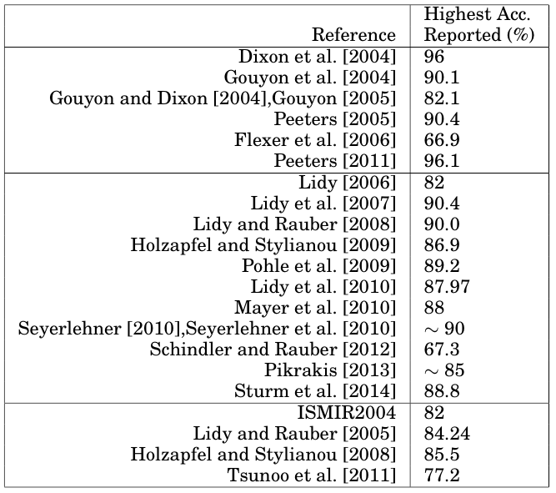
Meaningful Results?
What have these systems learned?
Which of them can help connect users with music and information about music?

Slide 44
There are others
What have these systems learned?
Are they all solving the same problem?
B. L. Sturm, “The state of the art ten years after a state of the art: Future research in music information retrieval,” J. New Music Research, vol. 43, no. 2, pp. 147-172, 2014.

Slide 45
So what if it is based on confounds?

Slide 46
if I need 70% performance, then this will do.

Slide 47
It won’t be 70% when the (fragile) confounds break.

Slide 48
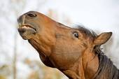
What do we want to do?
Connect users with music and information about music
Help users make music and information about music
Develop new technologies and show that they contribute
People, Scholars, Musicians, Schools, Organisations, Archives, Rights holders, Businesses, …
Michael Tompsett, Musical Instruments Map Of The World Map (http://fineartamerica.com)
M. Casey, R. Veltkamp, M. Goto, M. Leman, C. Rhodes, and M. Slaney, “Content-based music information retrieval: Current directions and future challenges,” Proc. IEEE, vol. 96, pp. 668-696, Apr. 2008.

Slide 49
Wait. What’s that about the horse again
?

Slide 50
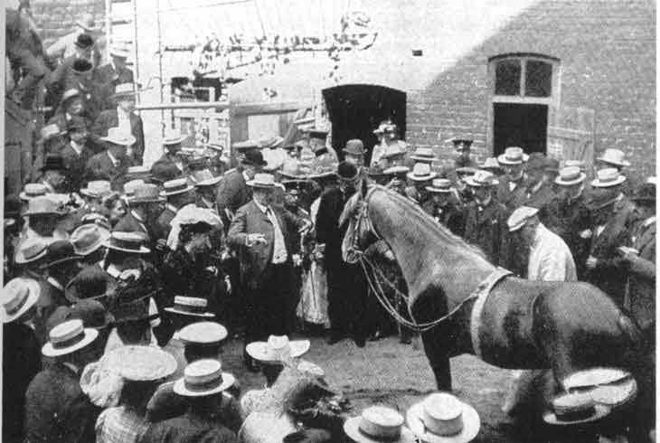
Can clever hans add two numbers?
Classification experiment:
In front of an audience, von Osten poses many problems to Hans, which taps out the answers. His answers are compared to the true solutions and Hans gets 100% right! (True story)
Does this have the validity to answer our question?

Slide 51
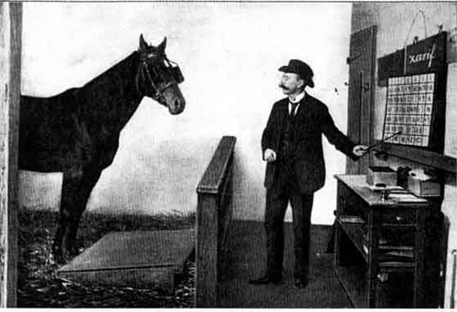
Hans’s magic revealed!
How can we validly test the claim that Hans can add two numbers?
Pfungst showed by controlling variables:
Hans lost its abilities when the questioner was out of view, or when the questioner did not know the correct answer.
Hans responded based on involuntary cues of the questioner.
O. Pfungst (translated by C. L. Rahn), Clever Hans (The horse of Mr. Von Osten): A contribution to experimental animal and human psychology. New York: Henry Holt, 1911.

Slide 52
Classification accuracy is not enough!!
Even though a system tested in some dataset has good figures of merit, that is not enough (even if it reproduces all ground truth labels) to claim the system is doing what it appears to be doing.
There are other ways to reproduce ground truth than by chance or by “intelligence.”
B. L. Sturm, “Classification Accuracy Is Not Enough: On the Evaluation of Music Genre Recognition Systems,” J. Intelligent Info. Systems, 41(3): 371-406, 2013.
B. L. Sturm, “A simple method to determine if a music information retrieval system is a “horse”,” IEEE Trans. Multimedia, vol. 16, no. 6, pp. 1636-1644, 2014.

Slide 53
If you can elicit any response from A system by changing irrelevant factors, then It’s likely a horse.
B. L. Sturm, “A simple method to determine if a music information retrieval system is a ‘horse’,” IEEE Trans. Multimedia 16(6): 1636-1644, 2014.
NB: A “horse” is not necessarily useless.

Slide 54
Whatare some ways forward
?

Slide 55
First, Define the objective
To be objective, one must first define the objective.
Meaningful evaluation depends critically upon defining the objective in no uncertain terms.
What exactly is the task intended for a system?
Connecting users with music and information about music.
Identify repeating rhythmic patterns?
Accurately estimate tempo
Recognise playing musical instruments
Multipitch estimation
A dataset does not define a unique objective.

Slide 56
second, evaluate to the objective
A meaningful evaluation of a system is an experiment validly testing a hypothesis centred on its objective.
Validity: a capacity to test the hypothesis of interest
Meaningful: relevant to the objective
Assumptions: implicit or explicit statements of fact
e.g., ground truth can be reproduced in one of two ways: chance or intelligence about the task.
The design and analysis of experiments is absolutely necessary.
R. A. Bailey, Design of comparative experiments. Cambridge University Press, 2008.

Slide 57
third, Identify causes
Do not anthropomorphise a system.
Be suspicious of the appearance of “intelligence.”
Actively try to defeat your “intelligent” system.
Actively try to defeat the “intelligent” systems of others.
Identify the reasons behind the outcomes of an evaluation to find the limitations of a system in the real world, problems with the evaluation, problems with the problem, and ways of improving them all.

Slide 58
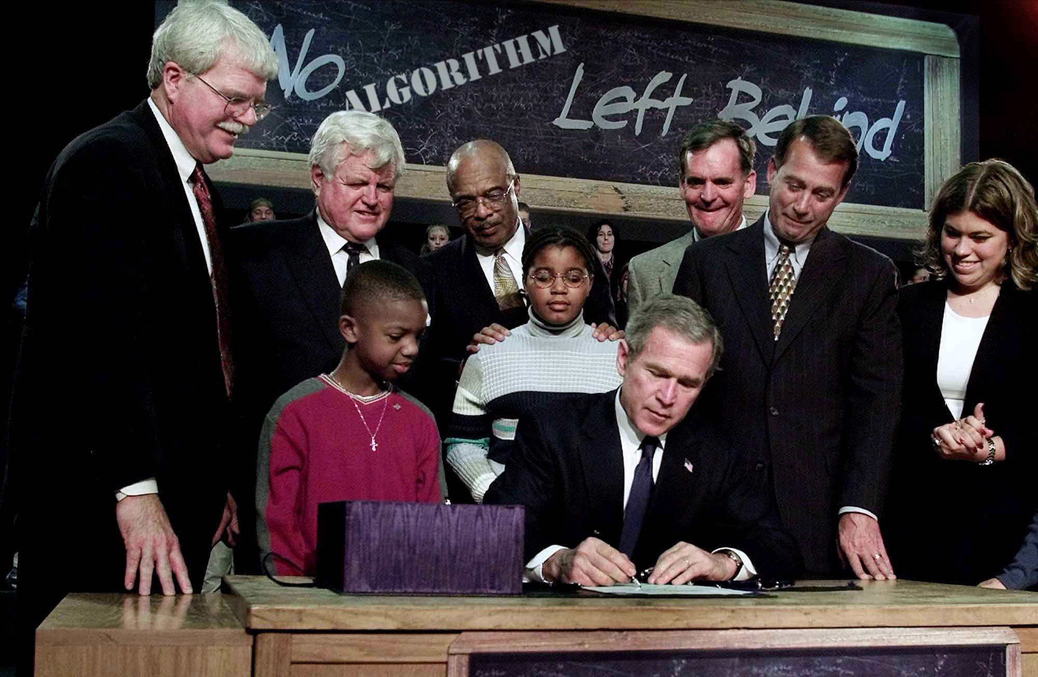
Fourth, N.A.L.B.
Progress is harmed when too much weight is given to precise numbers that actually mean nothing with respect to the goal.

Slide 59
Thank you
Bob L. Sturm
School of electronic engineering and computer science
Queen mary University of London

